Slide 1

Spring Web-flux Working with Netty Server, configuring Netty with Spring
Java Full Stack Program

Slide 2
Introduction to Spring WebFlux
Spring WebFlux is a reactive web framework that was introduced in Spring 5.
It is designed to enable developers to build asynchronous and non-blocking web applications that can handle large volumes of traffic while maintaining high performance and scalability.
The framework is built on top of the Reactive Streams API, which provides a common interface for dealing with asynchronous data streams.
This allows developers to write code that can process data as it arrives, rather than waiting for it to be fully received before processing.
Spring WebFlux provides a functional programming model for building reactive applications.
This means that instead of using traditional object-oriented programming patterns, developers write code that uses functions and lambda expressions to handle data streams and events.
Java Full Stack Program

Slide 3
The framework also supports a variety of reactive programming libraries and technologies, such as Reactive Streams, Project Reactor, and RxJava.
This allows developers to choose the best tools for their specific use case and take advantage of the full power of reactive programming.
Overall, Spring WebFlux provides a flexible and powerful framework for building reactive web applications that can handle high levels of concurrency and scalability.
It is well-suited for use cases where responsiveness and real-time data processing are critical, such as real-time analytics, IoT, and mobile applications.
Java Full Stack Program

Slide 4
Functional Programming in Spring WebFlux
Functional programming is a programming paradigm that emphasizes the use of functions to model the behavior of software systems.
In Spring WebFlux, functional programming is used to handle reactive data streams and events.
In functional programming, functions are treated as first-class citizens, meaning that they can be passed around as arguments, returned as values, and stored in data structures.
This allows for more concise and composable code, as functions can be combined and reused to create more complex behavior.
In Spring WebFlux, functional programming is used to define the routing and handling of incoming requests.
Instead of using traditional controllers and annotations, developers write functions that take in a request and return a response.
These functions are called "handlers" and can be composed together to form more complex routing and handling logic.
Java Full Stack Program

Slide 5
For example, consider the following code snippet that defines a handler for handling a GET request to the "/users" endpoint:
public Mono<ServerResponse> getUsers(ServerRequest request) {
Flux<User> users = userService.getUsers();
return ServerResponse.ok().body(users, User.class);
}
In this code snippet, the getUsers function takes in a ServerRequest object and returns a Mono<ServerResponse> object.
The function retrieves a stream of User objects from a userService and returns an ok response with the users as the response body.
This functional programming model provides a more flexible and composable way of handling requests and responses in Spring WebFlux applications.
It also makes it easier to write code that is reactive and non-blocking, as functions can be designed to work with streams of data rather than blocking until all data is received.
Java Full Stack Program

Slide 6
Spring WebFlux Architecture
Spring WebFlux is designed to be a reactive web framework that supports building highly scalable and performant applications.
Its architecture is based on the Reactive Streams API, which provides a common interface for dealing with asynchronous data streams.
At the heart of the Spring WebFlux architecture is the WebFlux runtime.
This runtime consists of several components that work together to provide the reactive capabilities of the framework.
Some of the key components of the WebFlux runtime include:
1. ServerRequest and ServerResponse: These are the central abstractions that represent incoming requests and outgoing responses in Spring WebFlux.
Java Full Stack Program

Slide 7
2. RouterFunctions: This is a functional API for defining routes and handling requests in a reactive way. It allows developers to define routes and handlers as functions, which can be composed together to form complex routing and handling logic.
3. WebHandler: This is the core interface that defines the behavior of a WebFlux handler. It is responsible for processing incoming requests and returning outgoing responses.
4. HandlerAdapter: This is responsible for adapting a WebHandler to the ServerHttpRequest and ServerHttpResponse interfaces that are used by the underlying HTTP server.
5. DispatcherHandler: This is the main entry point for incoming requests in the Spring WebFlux runtime. It is responsible for routing incoming requests to the appropriate WebHandler and managing the processing of the request and response streams.
Java Full Stack Program

Slide 8
6. Reactive Streams Adapters: Spring WebFlux provides adapters for integrating with various reactive programming libraries, such as Project Reactor and RxJava. These adapters allow developers to use the full power of these libraries to handle reactive data streams.
Overall, the architecture of Spring WebFlux is designed to support reactive programming and non-blocking I/O, allowing for highly scalable and performant web applications.
Its use of functional programming and reactive streams makes it a powerful tool for building modern, real-time applications that can handle large volumes of traffic and data.
Java Full Stack Program

Slide 9
Handling Concurrency and Scalability in Spring WebFlux
Concurrency and scalability are key considerations when building web applications that need to handle a large volume of traffic and data. In Spring WebFlux, there are several strategies and tools that can be used to handle these challenges.
Reactive Programming:
Reactive programming is a key aspect of Spring WebFlux, and it is designed to handle concurrency and scalability by using non-blocking I/O and reactive data streams.
Reactive programming allows applications to handle many concurrent requests without blocking, which can improve scalability and reduce resource usage.
2. Asynchronous Processing:
Asynchronous processing is another important strategy for handling concurrency and scalability in Spring WebFlux.
By processing requests asynchronously, applications can handle more requests at the same time, and reduce the response time for each request.
Java Full Stack Program

Slide 10
3. Load Balancing:
Load balancing is a technique used to distribute the load across multiple instances of an application.
In Spring WebFlux, load balancing can be achieved using tools such as Spring Cloud LoadBalancer, which provides a client-side load balancing solution.
4. Caching:
Caching is a technique used to store frequently accessed data in memory or on disk, in order to reduce the amount of time it takes to retrieve the data.
In Spring WebFlux, caching can be implemented using tools such as Spring Cache, which provides a simple and flexible caching solution.
5. Reactive Database Drivers:
Reactive database drivers are designed to work with reactive programming and non-blocking I/O, allowing for improved concurrency and scalability when accessing databases.
In Spring WebFlux, developers can use reactive database drivers such as R2DBC or Spring Data R2DBC.
Java Full Stack Program

Slide 11
6. Microservices:
Microservices architecture is a popular approach for building highly scalable and distributed applications.
In Spring WebFlux, microservices can be implemented using tools such as Spring Cloud, which provides a suite of tools for building microservices-based applications.
Overall, Spring WebFlux provides several strategies and tools that can be used to handle concurrency and scalability in web applications. By using these tools and techniques, developers can build highly performant and scalable applications that can handle large volumes of traffic and data.
Java Full Stack Program

Slide 12
Advantages of Spring WebFlux:
Reactive Programming:
Spring WebFlux uses reactive programming, which allows applications to handle a large number of requests concurrently, using minimal resources.
This makes Spring WebFlux an ideal choice for building high-performance, scalable web applications.
2. Non-blocking I/O:
Spring WebFlux uses non-blocking I/O, which allows requests to be processed asynchronously, without blocking the thread.
This improves the application's responsiveness, as the thread can be released to handle other requests while waiting for I/O operations to complete.
3. Flexibility:
Spring WebFlux provides a flexible programming model that allows developers to choose between annotation-based programming or functional programming.
This makes it easy to write code that is easy to understand and maintain.
Java Full Stack Program

Slide 13
4.Support for Reactive Streams:
Spring WebFlux provides built-in support for Reactive Streams, which is a standard for asynchronous stream processing with non-blocking backpressure.
This makes it easy to work with reactive data streams in Spring WebFlux.
5.Integration with Spring Ecosystem:
Spring WebFlux integrates seamlessly with the rest of the Spring ecosystem, including Spring Security, Spring Data, and Spring Cloud.
This makes it easy to build and deploy reactive applications using Spring.
Java Full Stack Program

Slide 14
Disadvantages of Spring WebFlux:
Steep Learning Curve:
Reactive programming can have a steep learning curve, especially if you are not familiar with the reactive programming model.
This can make it challenging for developers who are new to reactive programming to get started with Spring WebFlux.
2. Performance Overhead:
While reactive programming can improve application performance, it can also introduce some performance overhead, especially if the application is not designed properly.
This can result in increased memory usage and higher CPU utilization, which can impact application performance.
Java Full Stack Program

Slide 15
3.Limited Tooling Support:
Compared to traditional Spring MVC, Spring WebFlux has limited tooling support.
This can make it challenging to find third-party libraries and tools that support reactive programming and Spring WebFlux.
4. Limited Compatibility:
Not all libraries and frameworks are compatible with reactive programming and Spring WebFlux.
This can limit the ability to reuse existing code or to integrate with other systems that do not support reactive programming.
Java Full Stack Program

Slide 16
Definition of Spring Boot Netty
It is an event-driven application framework that was used in-network, it will provide the HTTP, UDP, and non-blocking server and client. As per the name spring boot, netty is based on the netty framework, it is also known as the non-blocking input and output (NIO) framework.
We can use the framework as highly scalable, to build the low-level server is straightforward by using netty. Spring boot netty developer also works on socket level, an example to create communication protocol.
Java Full Stack Program

Slide 17
What is spring boot netty?
It supports APIs of non-blocking and blocking also it will support the SSL and TLS.
We can run our all-request synchronously on each thread. To run each thread synchronously it uses the blocking server model.
It is basically designed to make the easy implementation of custom network protocols. We can write our own protocol.
How to use spring boot netty?
To use the netty in our spring boot application we need to follow the below steps as follows.
Java Full Stack Program

Slide 18
We need to add the spring boot starter webflux dependency in the pom.xml file.
After adding the spring boot starter webflux dependency it will automatically add the spring boot starter reactor dependency in our project.
After adding the dependency in the application pom.xml file next step is to configure the server. We can configure the server by using two methods.
The first method to configure the server is by using the properties file. Spring boot exposes the common configuration by using the application properties file. We need to define the server port in the properties file.
We can also do the same configuration by using the application.yml file. Apart from the server port spring boot contains the other options of server configuration.
The application properties which was starting from the server prefix which was overriding the configuration of the default server.
We can also configure the server by using the programmatic configuration.
Java Full Stack Program

Slide 19
To configure the server through code spring boot uses the
NettyServerCustomizer and WebServerFactoryCustomizer classes.
To configure the server by using the programmatic configuration spring boot uses the component of the factory customizer at the time of startup.
Spring boot automatically configures the configuration of the server while adding starter dependency in pom.xml file so we need to skip auto configuration by defining the bean of NettyReactiveWebServerFactory.
To skip auto-configuration of the server we need to define the bean in our configuration class and need to add the customizer.
After configuring the server next step is to configure the SSL. To configure the SSL in the spring boot netty project we need to use SslServerCustomizer class in our project.
After configuring SSL in our application next step is to access the log information. In the project, we cannot access the logging by using logback.
Java Full Stack Program

Slide 20
Spring boot is configuring the access logging by using the file of application properties for tomcat and jetty server.
To enable the logging we need to set the netty http server access log enables parameter value as true at the time of running the application.
Custom Method spring boot netty
We can configure the application by using custom method. We need to create a project template by using a spring initializer.
We can also create the project by creating a new project using eclipse or the spring tool suite.
After creating the project using spring initializer next step is to add the dependency package in the pom.xml file.
After adding the dependency package we are going to create a server by using a custom method.
Java Full Stack Program

Slide 21
Custom method uses the netty to send and receive the object of java. Custom method is very useful to create the applications.
Custom method is used in the property-based configuration of spring boot. We can configure the server in a fine-grained manner.
Using custom method we can configure the netty server by using the code. We need to add some classes in our application.
Java Full Stack Program

Slide 22
configuring Netty with Spring
Below examples shows to create the server configuration are as follows.
1) Create project template using spring initializer and give name to project –
In the below step, we have provided project group name as com. example, artifact name as springboot-netty, project name as springboot-netty, and package as jar file.
Group – com.example
Artifact name – springboot-netty
Name – springboot-netty
Description – Project for springboot-netty
Spring boot – 2.5.5
Project – Maven project
Package name – com.example.springboot-netty
Packaging – Jar
Java – 11
Dependencies – spring native, spring web, spring reactive web.
Java Full Stack Program

Slide 23
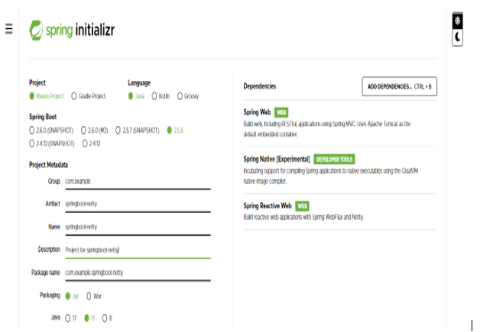
Java Full Stack Program

Slide 24

2) After generating project extract files and open this project by
using spring tool suite –
Java Full Stack Program

Slide 25
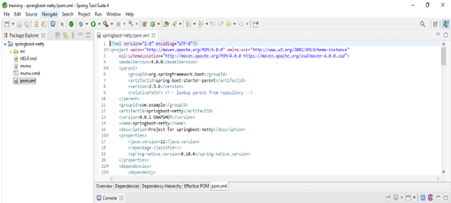
3) After opening project using spring tool suite check the project and its files –
Java Full Stack Program

Slide 26
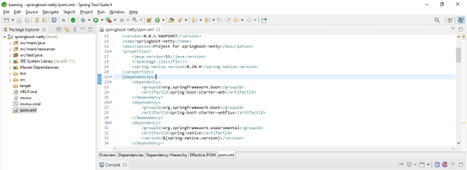
4) Add dependency packages –
<dependency> -- Start of dependency tag.
<groupId>org.springframework.boot</groupId> -- Start and end of groupId tag.
<artifactId>spring-boot-starter-webflux</artifactId> -- Start and end of artifactId tag.
</dependency> -- End of dependency tag.
Java Full Stack Program

Slide 27
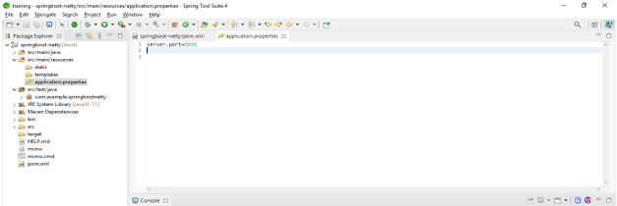
5) Configure the server using application.properties file.
Server.port = 8080
Java Full Stack Program

Slide 28
6) Configure the SSL –
@Component
public class NettyWebServerFactorySslCustomizer
implements WebServerFactoryCustomizer<NettyReactiveWebServerFactory> {
@Override
public void customize(NettyReactiveWebServerFactory serverFactory) {
Ssl ssl = new Ssl();
ssl.setEnabled (true);
ssl.setKeyStore ("classpath:sample.jks");
ssl.setKeyAlias ("netty");
ssl.setKeyPassword ("pass");
ssl.setKeyStorePassword ("pass");
}
}
Java Full Stack Program

Slide 29
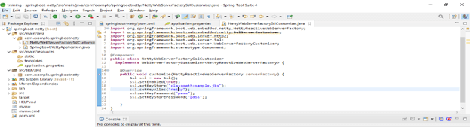
Java Full Stack Program

Slide 30
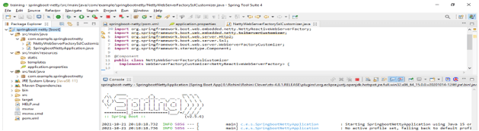
7) Run the application by using spring boot netty –
Java Full Stack Program

Slide 31
Conclusion
This framework supports APIs of non-blocking and blocking also it will support the SSL and TLS. It is basically designed to make the easy implementation of custom network protocols. We can write our own protocol.
Java Full Stack Program

Slide 32
THANK YOU
Java Full Stack Program

